Slide 1
HbbTV Certification and Testing
Simon Waller, Samsung Electronics
Andy Hickman, Digital TV Labs

Slide 2
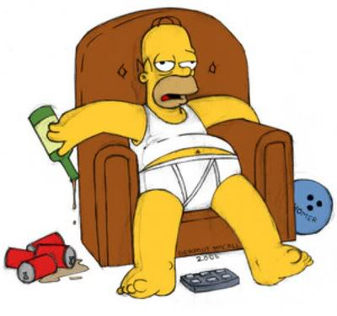
Viewer expectation
Alternative UI methods
Typical TV viewer
Location of remote control
Notes:
Viewers have to be coaxed into any interaction with the TV.
Interaction may be via remote control, or other means such as voice and gesture.
They expect the TV to work. They will not do software updates.

Slide 3
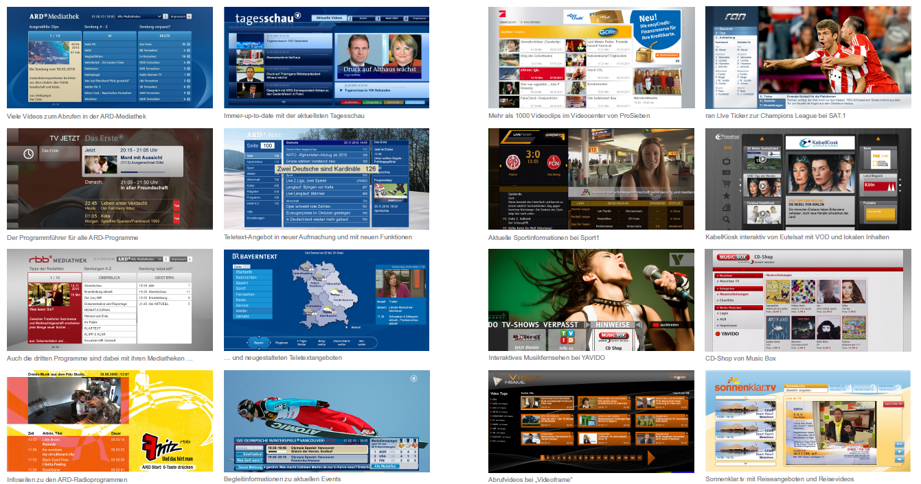
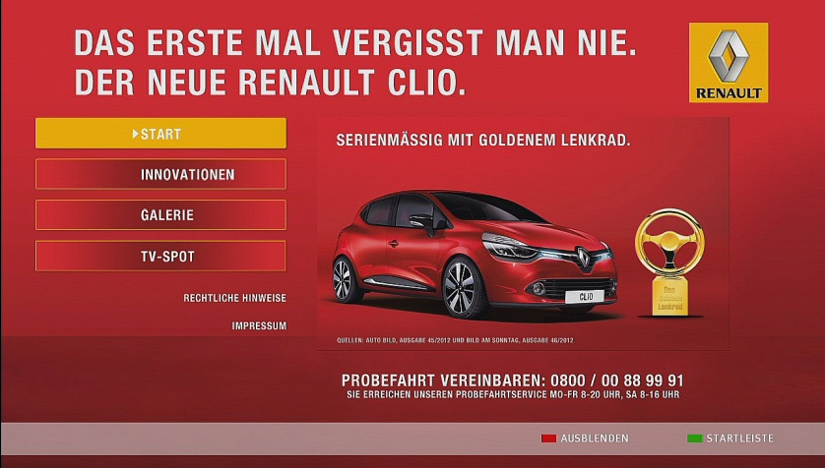
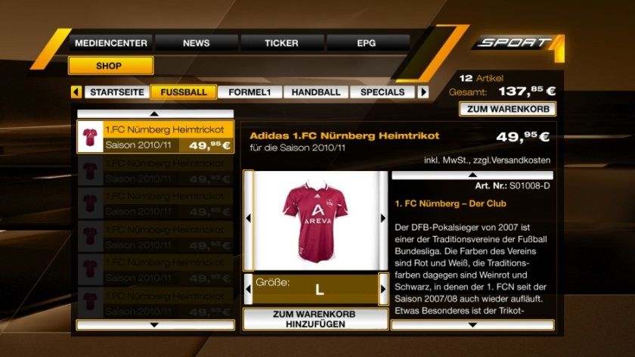
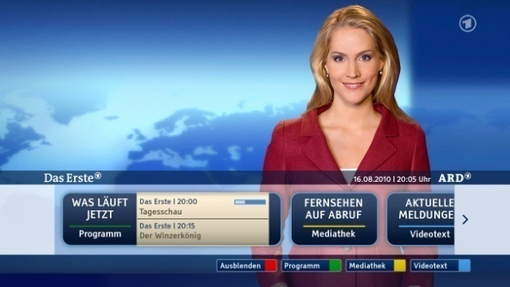
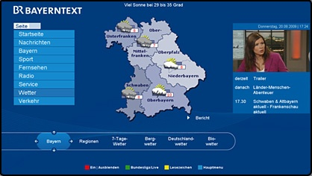
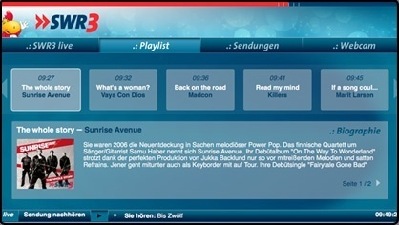
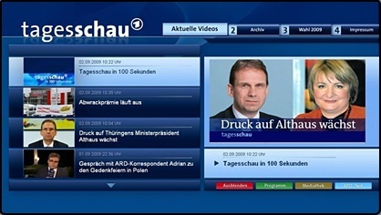
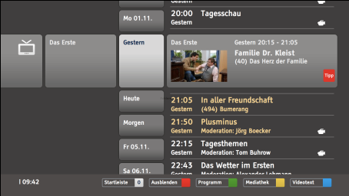
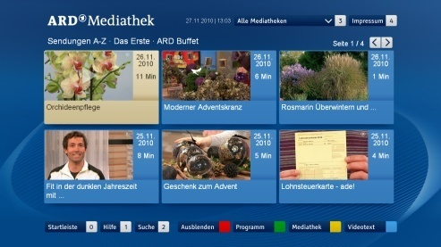
Broadcaster expectation
Broadcasters expect applications to be displayed the same on all TVs
TVs want to present the application in the same way
There are ~10 new browsers launched every year (covering ~90% of Smart TVs)
(and no software updates)
How can viewers know whether applications will be rendered correctly?
Notes:
Well over 100 HbbTV apps – not a big deal for web but is for TV.

Slide 4
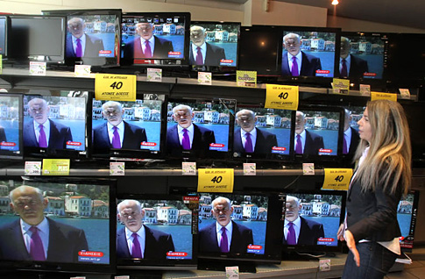
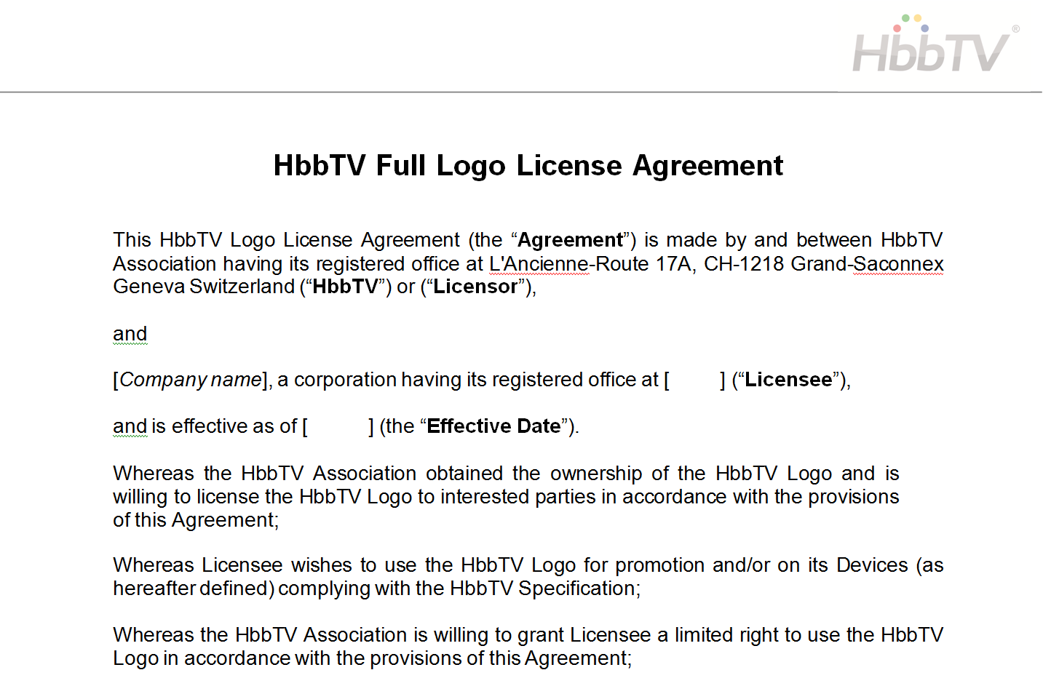
Giving viewers confidence
TV has logo on the product (or its packaging)
TV manufacturer has signed binding agreement
Notes:
Depending upon the market, a logo can give confidence to buyers (not necessarily HbbTV logo).
If HbbTV logo used, manufacturers are signing up to ensuring that their device passes the test suite.

Slide 5
HbbTV Logo License Agreement
TV has to pass HbbTV Test Suite
Manufacturer commits to try to resolve interoperability problems
If TV is proven to be non-compliant, manufacturer must update the TV software
Notes:
Note these are legal obligations so important for test suite to be correct.

Slide 6
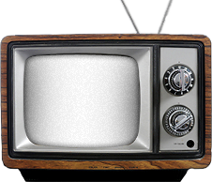
HbbTV Testing System Overview
HbbTV Test Harness
DVB-T/S/C Transport Stream (A/V, DSM-CC, SI)
HbbTV Test Application, IP-delivered Media
HbbTV Testing API:
Instructions to Tester, Screen Captures, Test Results
Receiver Under Test
Test Case
Test Case XML
Test Assertion
Test Suite
Test Procedure
Test Material & Implementation

Slide 7
Test Case Description XMLs - everything needed to manage tests
For test interpretation and execution
Title & test ID
Assertion and pass criteria text
Description text
Test procedure and test steps
For test plan management within test harness
Specification references (e.g. select all chapter 6 tests)
Applicability references (e.g. select all v1.5 tests)
Pre-conditions (e.g. needs CI+)
For test material creation process management
Version number
History & review status
Licensing information

Slide 8
HbbTV testing – W3C comparison
HbbTV Test Requirement | W3C test comparison
Comprehensive test metadata | Reduced test metadata
Test case list precisely defined and versioned | Not required
Overall binary pass/fail is important to practical commercial use of test suite | Very unlikely for a browser to pass 100% of tests
Quick to run, automated where possible | Ditto
No single test harness / runner – abstract test case material from tool used to run them | ?
Local test server | Global test server, could set up locally?
Generates a machine readable test report | Yes?
Can be run on a retail device with no special modifications | Equivalent. Can be run on a stock browser
DRM not tested | EME testing is being addressed?
Video testing (DASH, trick modes, codec variations, etc.) – hugely important | Mainly out of scope?

Slide 9
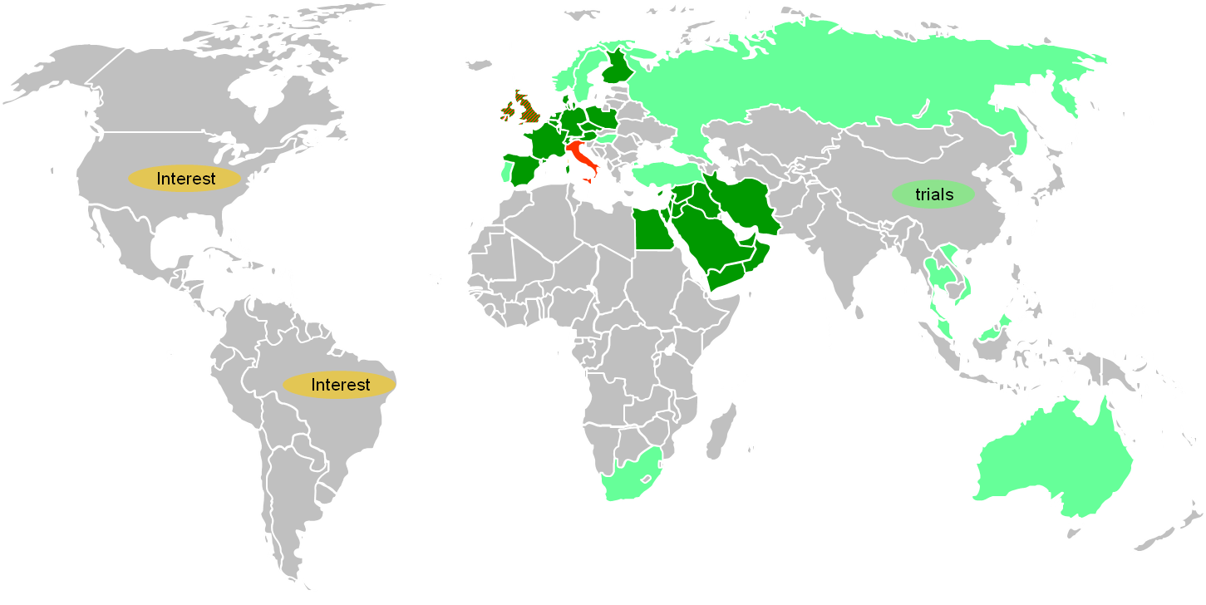
Conclusion
HbbTV is being used in many countries around the world.
HbbTV builds upon W3C Recommendations. It is important for broadcasters and manufacturers to allow HbbTV to be more closely aligned with W3C.
All specifications must meet the questions:
Is it written in a testable manner?
Will it be (fully) implemented?
How will tests be provided for it?
The number of applications is growing.
The number of devices supporting HbbTV is growing.
Better specifications → Better tests → Better compatibility → Better user experience.
Sharing of tests and test approaches between W3C and HbbTV will be mutually beneficial.
When designing test approaches for CE devices it's important to understand use of device certification and software updates in the product lifecycle and how different it is from the traditional browser testing world.
Broadcasters want compatibility between web apps and broadcast apps.

